Slide 1


Al-Karkh University for Science
Collage of Science
Medical Physics Department
General Biology II
" Practical"
Prepared by
Dr. Hiba Shakir Ahmed Dr. Rawa Abdul Redha Aziz
Ph.D Microbiology/Immunity Ph.D Antibiotic Molecular Biology

Slide 2
Bacterial growth
LAB ((3))

Slide 3
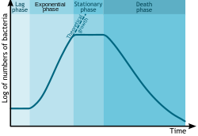
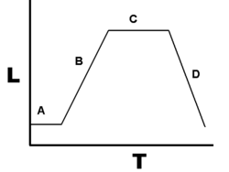
Bacterial growth is the asexual reproduction, or cell division, of a bacterium into two daughter cells, in a process called binary fission. Providing no mutational event occurs, the resulting daughter cells are genetically identical to the original cell.
Bacterial growth curve\Kinetic Curve

Slide 4
Phases
In the growth of bacteria (or other microorganisms,as protozoa, microalgae or yeasts) in culture can be modeled with four different phases: lag phase (A), log phase or exponential phase (B), stationary phase (C), and death phase(D).

Slide 5
Lag phase
1- lag phase, bacteria adapt themselves to growth conditions. It is the period where the individual bacteria are maturing and not yet able to divide. During the lag phase of the bacterial growth cycle, synthesis of RNA, enzymes and other molecules occurs. During the lag phase cells change very little because the cells do not immediately reproduce in a new medium. This period can last for 1 hour to several days. During this phase cells are not dormant.

Slide 6
2- log phase (sometimes called the logarithmic phase or the exponential phase) is a period characterized by cell doubling. The number of new bacteria appearing per unit time is proportional to the present population.
3- stationary phase is often due to a growth-limiting factor such as the depletion of an essential nutrient, and/or the formation of an inhibitory product such as an organic acid. Stationary phase results from a situation in which growth rate and death rate are equal. Mutations can occur during stationary phase.
4- death phase (decline phase), bacteria die. This could be caused by lack of nutrients, environmental temperature or other injurious conditions.

Slide 7
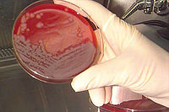
Bacterial culture
There are several types of bacterial culture methods that are selected based on the agent being cultured and the downstream use.
Materials and equipment:
agar plates inoculated by spread plate technique
agar slants
inoculating loop
Bunsen burner
Incubator

Slide 8
Practice
1- Label slant to be inoculated with the date, your name and name/code/ number of isolate. Select adequate colonies from the plate culture by marking them on the bottom of the Petri dish.
2- Take the inoculating loop and hold it like a pencil. Flame the inoculating loop over a Bunsen burner until the wire becomes red-hot.
3- Open the lid of the Petri dish culture to a gap and cool the hot loop by inserting it into the agar without touching any colonies developed on the surface. Choose a discrete colony and pick a loopful of inoculum using the inoculating loop, and then close the lid of the Petri dish.

Slide 9
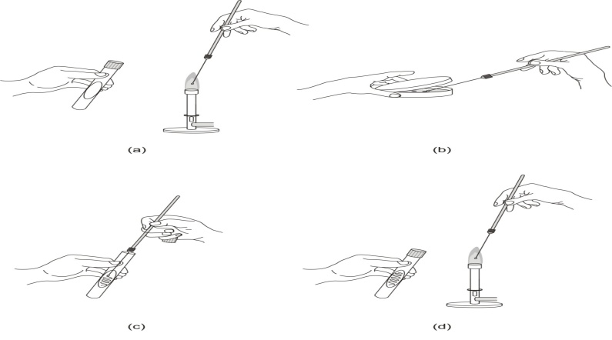
4- Using the same hand that is holding the inoculating loop, remove the cap from a test tube, hold it between your fingers, and briefly flame the neck of the tube over a Bunsen burner by passing through the flame.
5- Inoculate the surface of the agar slant in zigzag streaks using the infected inoculating loop.

Slide 10
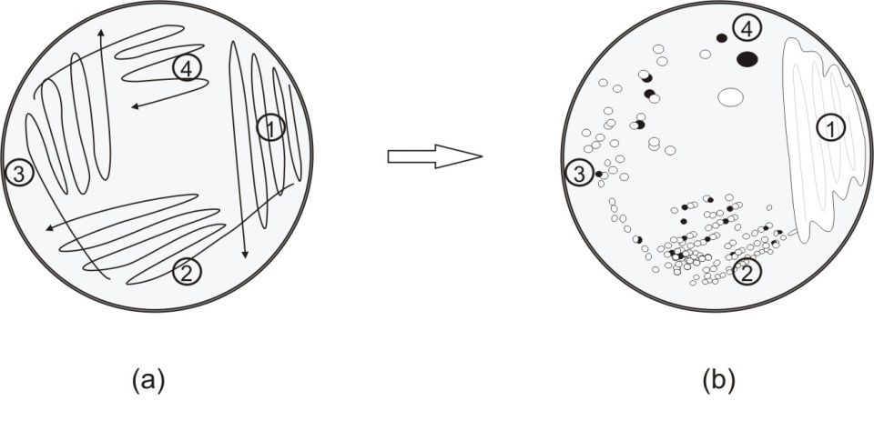
6- Flame the neck of the tube again and close it with the cap.
7- Sterilise the loop again by flaming over a Bunsen burner until the wire becomes red-hot. Take care to place the infected loop first into the core of the flame, and then slowly pull it upwards until it becomes red-hot.
8- Place the tube and the inoculating loop on the rack.
9- Incubate the slant at 28°C for one week.
10- Check the growth of the isolate after the incubation period.

